Slide 1

INTRODUCTION
Like a String, list also is sequence data type. It is an ordered set of values enclosed in square brackets []. Values in the list can be modified, i.e. it is mutable. As it is set of values, we can use index in square brackets [] to identify a value belonging to it. The values that make up a list are called its elements, and they can be of any type.

Slide 2
INTRODUCTION
We can also say that list data type is a container that holds a number of elements in a given order. For accessing an element of the list, indexing is used.
Syntax is :
Variable name [index]
It will provide the value at „index+1‟ in the list. Index here, has to be an integer value which can be positive or negative.

Slide 3
INTRODUCTION
Positive value of index means counting forward from beginning of the list and negative value means counting backward from end of the list.
Remember the result of indexing a list is the value of type accessed from the list.
NOTE: LISTS ARE MUTABLE IN NATURE

Slide 4
CREATING LIST

Slide 5
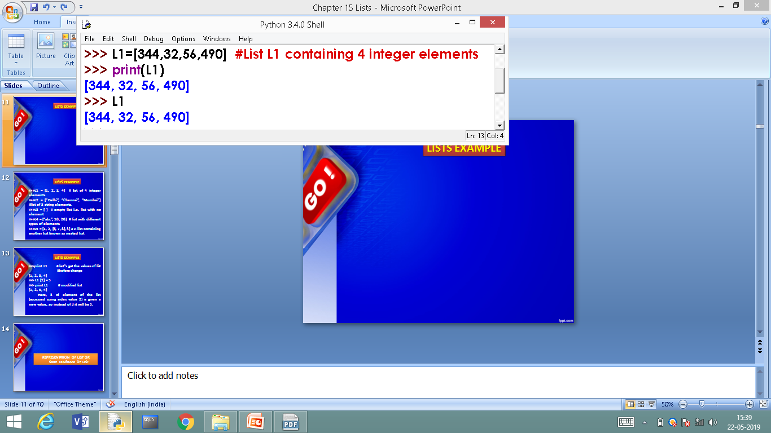
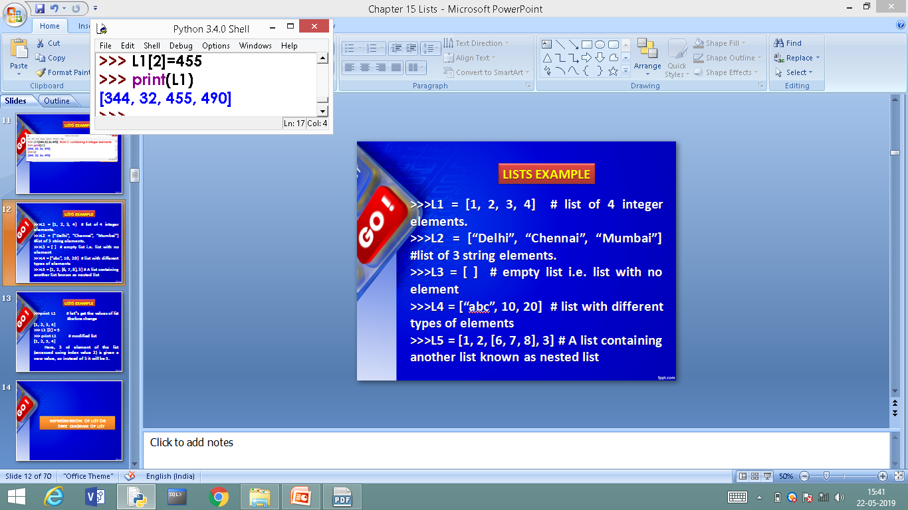
LISTS EXAMPLE
3rd Element of list modified.

Slide 6
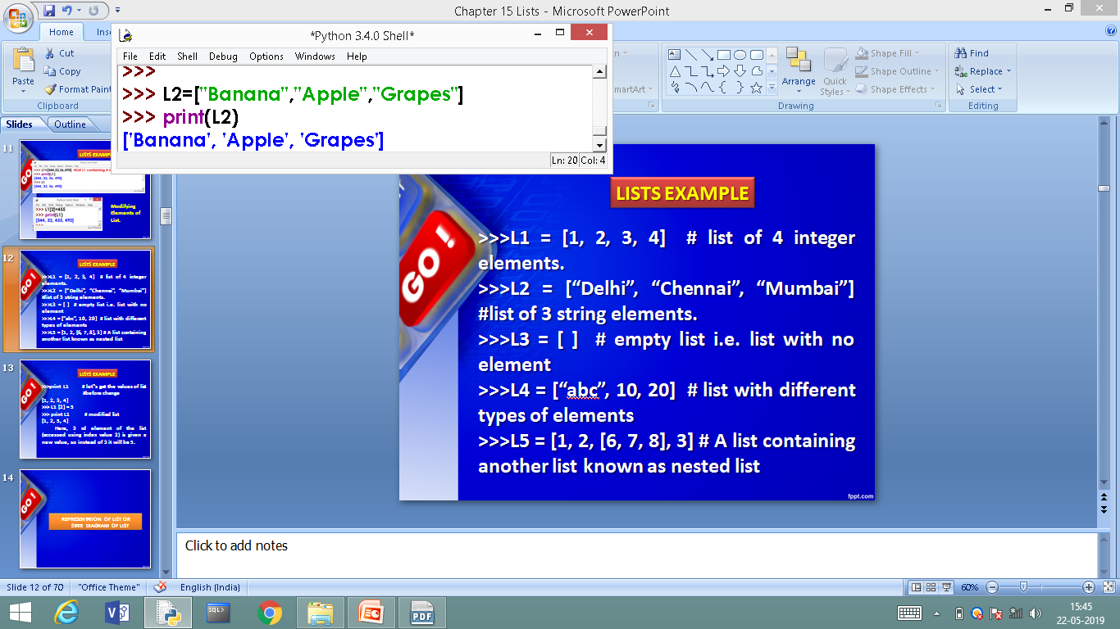
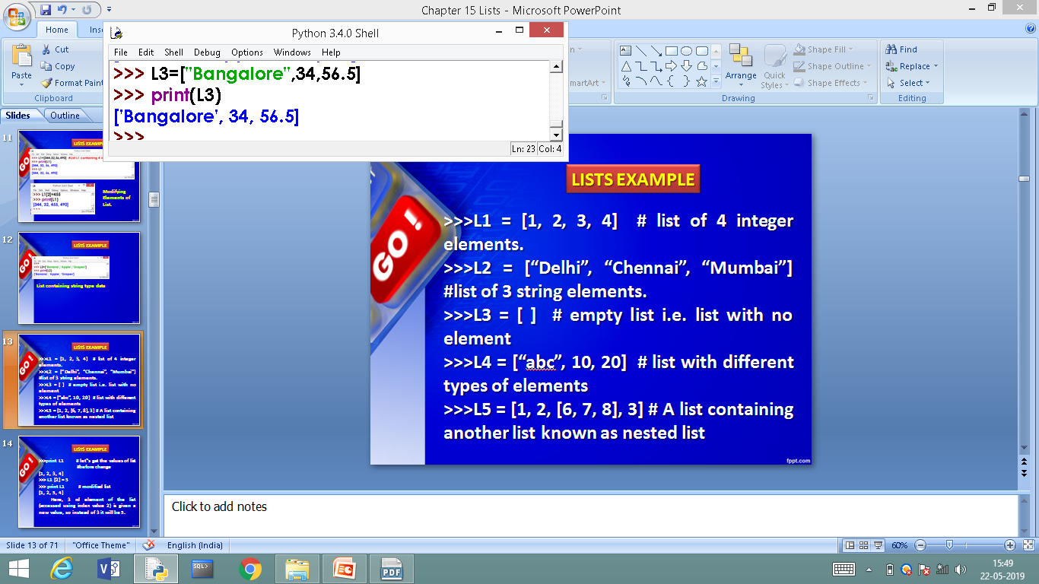
LISTS EXAMPLE
List containing string type data
List containing mixed data

Slide 7
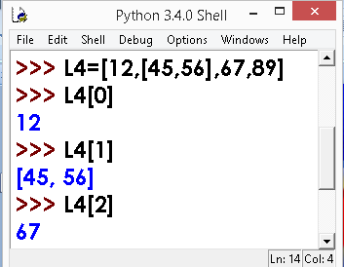
LISTS EXAMPLE
A list containing another list known as nested list.

Slide 8
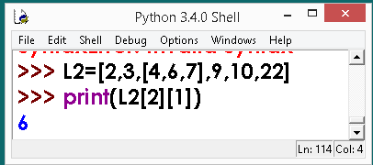
LISTS EXAMPLE
Use double subscript to fetch the sub list in a given list.
Similarly, L2[2][0] will fetch you 4 value
L2[2][2] will fetch you 7 value.

Slide 9
REPRESENTATION OF LIST OR STATE DIAGRAM OF LIST

Slide 10
STATE DIAGRAM OF LIST
>>> L1 = [45,56,67,20]
State Diagram would be:
Forward Indexing
0
45
-4
1
56
-3
2
67
-2
3
20
-1
Backward Indexing
LIST INDEX
LIST elements

Slide 11
STATE DIAGRAM OF LIST
>>> L2 = [“Mouse”,Pendrive”,”RAM”]
State Diagram would be:
Forward Indexing
0
Mouse
-3
1
Pendrive
-2
2
RAM
-1
Backward Indexing
LIST INDEX
LIST elements

Slide 12
STATE DIAGRAM OF LIST
>>> L3= []
State Diagram would be:

Slide 13
WORKING WITH LIST INDEX

Slide 14
WORKING WITH LIST INDEX
List index works the same way as String index, which is:
An integer value/expression can be used as index.
An Index Error appears, if you try and access element that does not exist in the list.
An index can have a negative value, in that case counting happens from the end of the list.

Slide 15
SOME MORE EXAMPLE

Slide 16
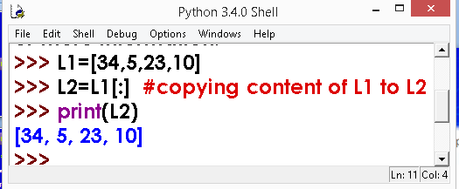
LIST - Example

Slide 17
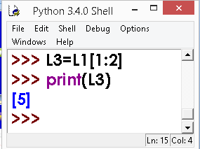
LIST - Example

Slide 18
CREATING LIST WITH list( ) METHOD

Slide 19
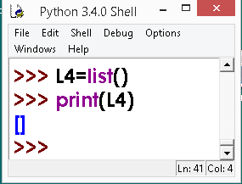
CREATING LIST WITH list( ) METHOD
Creating Empty List
With list( ) Method

Slide 20
CREATING LIST WITH list( ) METHOD
Creating Empty List
With list( ) Method

Slide 21
CREATING MULTIPLE LISTS – LIST MAPPING

Slide 22
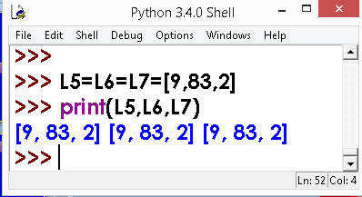
CREATING MULTIPLE LISTS – LIST MAPPING
Creating a list and mapping to other lists.
Creating Multiple List using assignment statement

Slide 23
LIST CONCATENATION

Slide 24
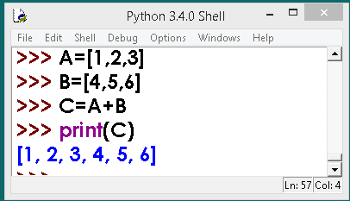
LIST CONCATENATION
A and B are two different LISTS and third LIST is created by combining both A and B.

Slide 25
LIST SLICING

Slide 26
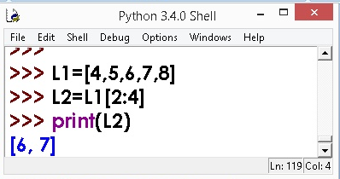
LIST SLICING
Like String slicing, Lists can also be sliced, as you have seen in previous slides.

Slide 27
COPYING ALTERNATIVE ELEMENTS OF LIST BY SLICING

Slide 28
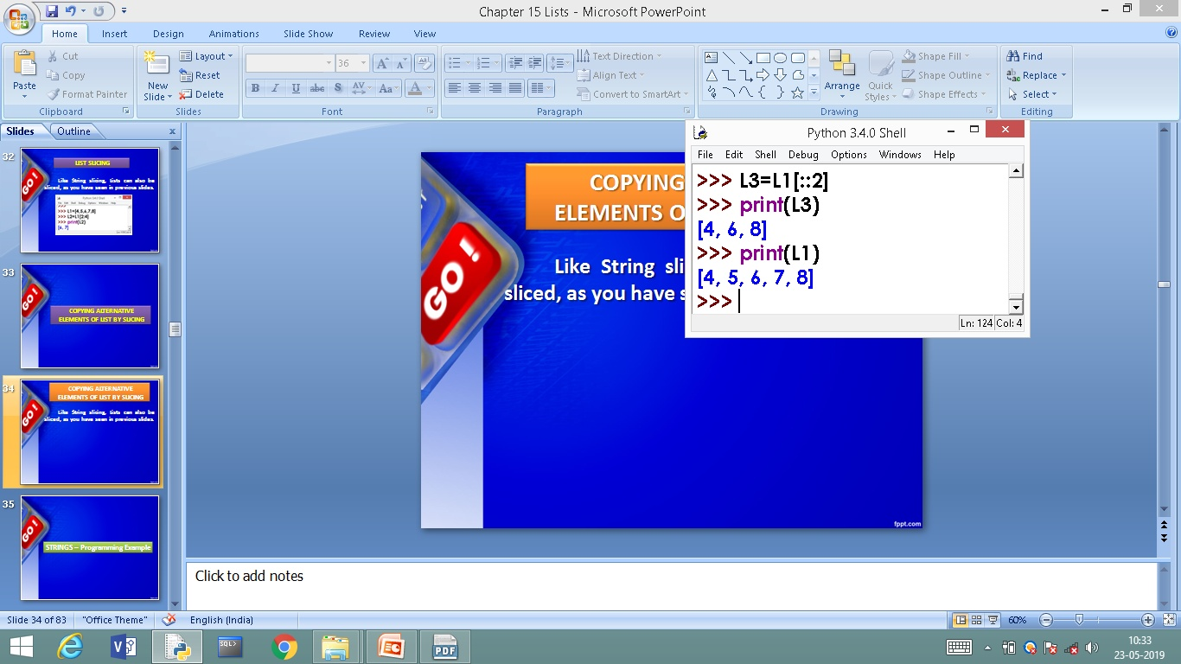
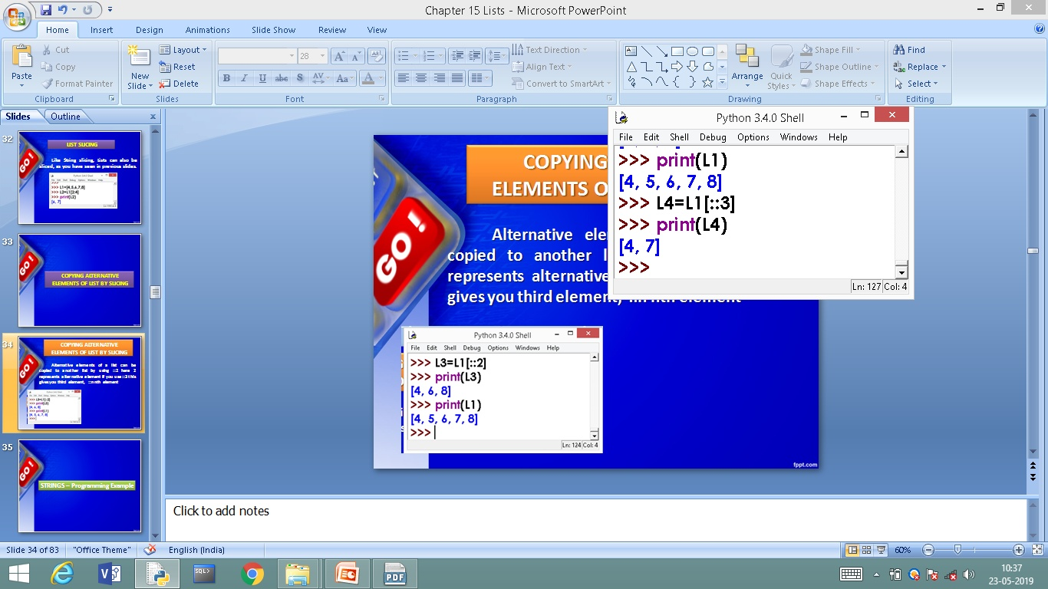
COPYING ALTERNATIVE ELEMENTS OF LIST BY SLICING
Alternative elements of a list can be copied to another list by using ::2 here 2 represents alternative element if you use ::3 this gives you third element, ::n nth element

Slide 29
READING LIST THROUGH KEYBOARD
USE OF append ( ) Method

Slide 30
READING LIST THROUGH KEYBOARD
USE OF append ( ) Method
append () method is used to add elements to the end of list. Every time new element is assigned using append it will be added at the rear side of list
Syntax:
Listobject.append(element)
Example
L1.append(587) OR
element=int(input())
L1.append(element)

Slide 31
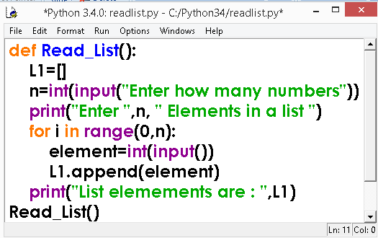
Reading a LIST – Use append ( ) Method
Elements read during run time
Contd… next slide

Slide 32
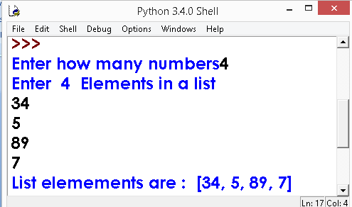
Reading a LIST – Use append ( ) Method
OUTPUT

Slide 33
TRAVERSING LIST

Slide 34
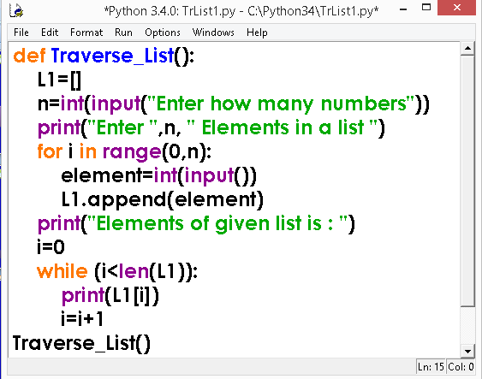
TRAVERSING LIST
Fetching all the elements of list using loop

Slide 35
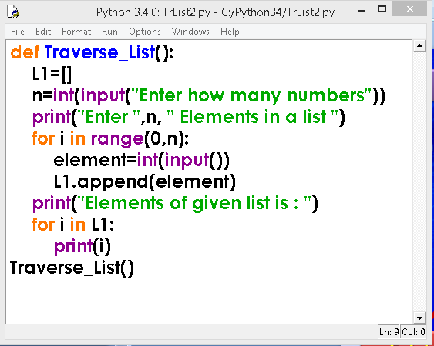
TRAVERSING LIST
Traversing list using for loop
Contd… next slide

Slide 36
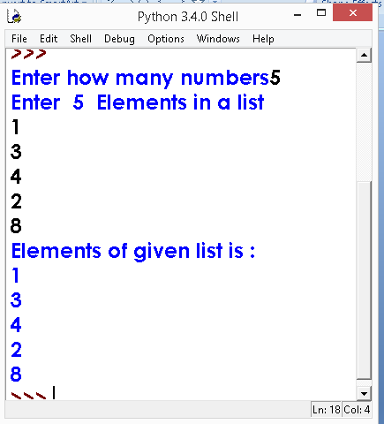
TRAVERSING LIST
OUT PUT

Slide 37
Deleting Elements of LIST

Slide 38
Deleting Elements of LIST
It is possible to delete/remove element(s) from the list. There are many ways of doing so:
(i) If index is known, we can use pop ( ) or del
(ii) If the element is known, not the index, remove ( ) can be used.
(iii) To remove more than one element, del ( ) with list slice can be used.
(iv) Using assignment operator

Slide 39
Deleting Elements of LIST
1. pop ( ) Method
2. del Method
3. remove ( ) Method

Slide 40
Deleting Elements of LIST
1. pop ( ) Method
It removes the element from the specified index, and also return the element which was removed.
Its syntax is:
List.pop ([index])

Slide 41
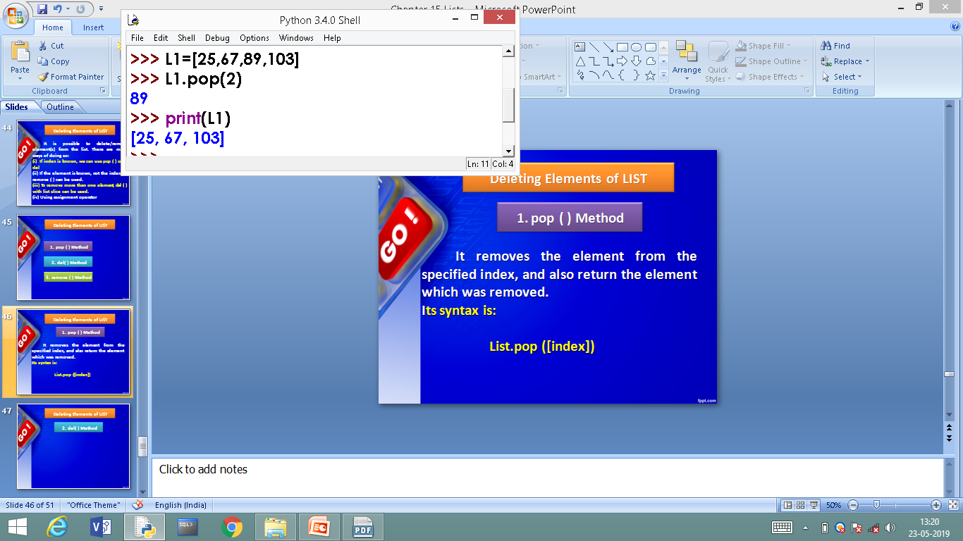
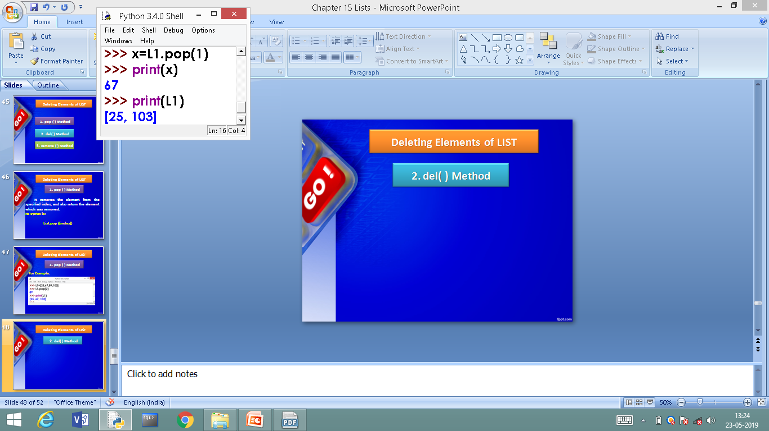
Deleting Elements of LIST
1. pop ( ) Method
For Example:
Popped element 67 is assigned to x

Slide 42
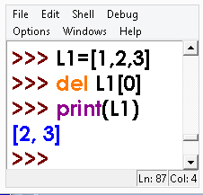
Deleting Elements of LIST
2. del Method
del removes the specified element from the list, but does not return the deleted value.
Syntax :
del Listobject[index]
del method example

Slide 43
Deleting Elements of LIST
3. remove ( ) Method
In case, we know the element to be deleted not the index, of the element, then remove () can be used.
Syntax is:
listobject.remove(value)
>>>L1.remove(60)
contd…

Slide 44
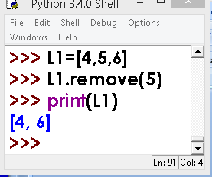
Deleting Elements of LIST
3. remove ( ) Method

Slide 45
SOME MORE METHODS

Slide 46
SOME MORE METHODS
1. insert () Method
2. reverse ( ) Method
3. sort ( ) Method
4. clear ( ) Method
5. index ( ) Method
6. extend ( ) Method

Slide 47
OTHER METHODS
1. insert () Method
This method allows us to insert an element, at the given position specified by its index, and the remaining elements are shifted to accommodate the new element. insert () requires two arguments-index value and item value.
Its syntax is
list. insert (index, item)

Slide 48
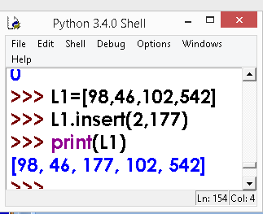
OTHER METHODS
1. insert () Method
For Example:

Slide 49
OTHER METHODS
2. reverse ( ) Method
This method can be used to reverse the elements of the list in place
Its syntax is:
list.reverse ( )
Method does not return anything as the reversed list is stored in the same variable.

Slide 50
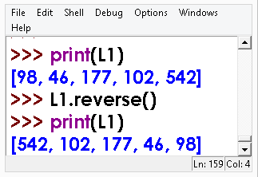
OTHER METHODS
2. reverse ( ) Method
For Example:

Slide 51
OTHER METHODS
3. sort ( ) Method
For arranging elements in an order Python provides a method sort ( ) and a function sorted ( ). sort ( ) modifies the list in place and sorted ( ) returns a new sorted list.

Slide 52
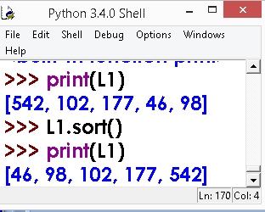
OTHER METHODS
3. sort ( ) Method
For Example:
Default Ascending
Order sorting

Slide 53
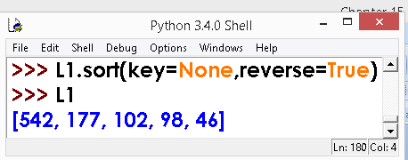
OTHER METHODS
3. sort ( ) Method
For Example:
Descending order

Slide 54
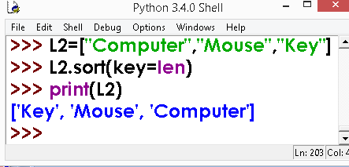
OTHER METHODS
3. sort ( ) Method
For Example:
Sorting using key value (length of string)

Slide 55
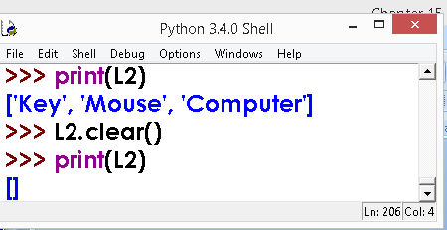
OTHER METHODS
4. clear ( ) Method
clear() method deletes
or clears the content of list. For Example:

Slide 56
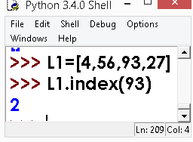
OTHER METHODS
5. index ( ) Method
To know the index of an
element in a given list
For Example:

Slide 57
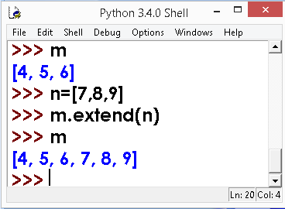
OTHER METHODS
6. extend ( ) Method
Extending a given list with
another list.
For Example:

Slide 58
PROGRAMS ON LISTS
BELLOW AVERAGE PROGRAMS ON LISTS

Slide 59
PROGRAMS ON LISTS
BELLOW AVERAGE PROGRAMS ON LISTS
Write a Python program to sum all the items in a list.
def sum_list(items):
sum_numbers = 0
for x in items:
sum_numbers += x
return sum_numbers
print(sum_list([1,2,-8]))

Slide 60
PROGRAMS ON LISTS
BELLOW AVERAGE PROGRAMS ON LISTS
2. Write a Python program to get the largest number from a list.
def max_num_in_list( list ):
max = list[ 0 ]
for a in list:
if a > max:
max = a
return max
print(max_num_in_list([1, 2, -8, 0]))

Slide 61
PROGRAMS ON LISTS
BELLOW AVERAGE PROGRAMS ON LISTS
3. Write a Python program to check a list is empty or not.
def check_list():
l = []
if not l:
print("List is empty")

Slide 62
PROGRAMS ON LISTS
BELLOW AVERAGE PROGRAMS ON LISTS
4. Write a Python program to clone or copy a list.
def clone_list():
original_list = [10, 22, 44, 23, 4]
new_list = list(original_list)
print(original_list)
print(new_list)

Slide 63
PROGRAMS ON LISTS
AVERAGE PROGRAMS ON LISTS

Slide 64
AVERAGE PROGRAMS ON LISTS
5. Write a Python function that takes two lists and returns True if they have at least one common member.
def common_data(list1, list2):
result = False
for x in list1:
for y in list2:
if x == y:
result = True
return result
print(common_data([1,2,3,4,5], [5,6,7,8,9]))
print(common_data([1,2,3,4,5], [6,7,8,9]))

Slide 65
AVERAGE PROGRAMS ON LISTS
5. Write a Python function that takes two lists and returns True if they have at least one common member.
def common_data(list1, list2):
result = False
for x in list1:
for y in list2:
if x == y:
result = True
return result
print(common_data([1,2,3,4,5], [5,6,7,8,9]))
print(common_data([1,2,3,4,5], [6,7,8,9]))

Slide 66
AVERAGE PROGRAMS ON LISTS
6. Write a Python program to generate and print a list of first and last 5 elements where the values are square of numbers between 1 and 30 (both included).
def printValues():
l = list()
for i in range(1,21):
l.append(i**2)
print(l[:5])
print(l[-5:])
printValues()

Slide 67
ABOVE AVERAGE PROGRAMS ON LISTS

Slide 68
ABOVE AVERAGE PROGRAMS ON LISTS
7 Write a Python program to generate and print a list except for the first 5 elements, where the values are square of numbers between 1 and 30 (both included).
def printValues():
l = list()
for i in range(1,21):
l.append(i**2)
print(l[5:])
printValues()

Slide 69
ABOVE AVERAGE PROGRAMS ON LISTS
8. Write a Python program to print the numbers of a specified list after removing even numbers from it.
def num_prn():
num = [7,8, 120, 25, 44, 20, 27]
num = [x for x in num if x%2!=0]
print(num)

Slide 70
ABOVE AVERAGE PROGRAMS ON LISTS
9. Write a Python program to print a specified list after removing the 0th, 4th and 5th elements.
Sample List : ['Red', 'Green', 'White', 'Black', 'Pink', 'Yellow']
Expected Output : ['Green', 'White', 'Black']
def prn_list()
color = ['Red', 'Green', 'White', 'Black', 'Pink', 'Yellow']
color = [x for (i,x) in enumerate(color) if i not in (0,4,5)]
print(color)

Slide 71
CLASS WORK/HOME WORK

Slide 72
CLASS WORK/HOME WORK
1. Write a Python program to generate a 3*4*6 3D array whose each element is *.
2.Write a Python program to shuffle and print a specified list.
3. Write a Python program to get the difference between the two lists.
4. Write a Python program access the index of a list.
5. Write a Python program to convert a list of characters into a string.
6. Write a Python program to find the index of an item in a specified list

Slide 73
Class Test

Slide 74
Class Test
Time: 40 Min Max Marks: 20
What is list? 02
Explain the various ways of creating list 03
Explain 5 list built in methods 10
Explain sort method with its various forms 05

Slide 75
Thank You

